Slide 1
Introduction to R Workshop
Session 5
Data Understanding: Stats
May 6, 2019

Slide 2
7:00 am
BALLROOM LOBBY
2ND FLOOR
-
8:00 am
BREAKFAST
8:00 am
-
8:10 am
Instructor and Course Introduction
8:10 am
-
9:50 am
Introduction to R and RStudio for Reproducible Reporting
9:50 am
-
10:10 am
REFRESHMENT BREAK
-
BALLROOM LOBBY
-
2ND FLOOR
10:10 am
-
11:50 am
Data Wrangling
12:00 pm
-
1:00 pm
LUNCH
BALLROOM LOBBY
2ND FLOOR
1:00 pm
-
2:50 pm
Data Understanding
2:50 pm
2ND FLOOR
-
3:10 pm
REFRESHMENT BREAK
-
BALLROOM LOBBY
-
3:10 pm
-
5:00 pm
Exploratory Data Analysis

Slide 3
Objectives
Be able to…
Summarize variables, including calculation of summary statistics
Break apart data frames observations into groups
Use standard statistical modeling functions
Compare variables’ distributions

Slide 4
Typical Data Science Pipeline
From R for Data Science (https://r4ds.had.co.nz/introduction.html)
Notes:
In this session we will focus on modeling. But, in the process, we will do a lot more data transformation

Slide 5
Summarize()

Slide 6
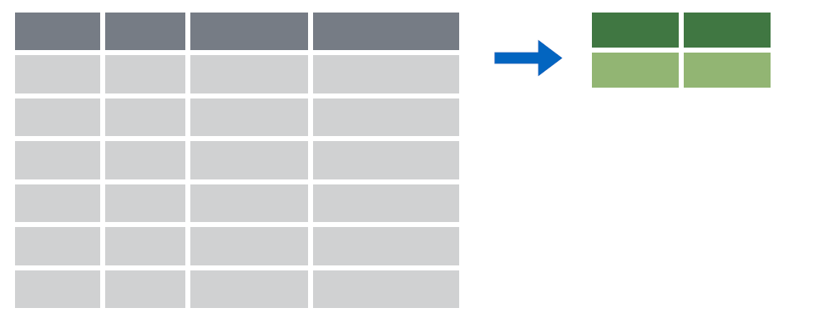

summarize()
Make summaries of your data
Notes:
Apply a function (or functions) to all observations of a variable and return a single value, or summary.

Slide 7
summarize()
Make summaries of your data
orders %>%
summarize(new_variable = calculation)
name for new variable
Value or function

Slide 8
summarize()
function that returns number of observations
Make summaries of your data
orders %>%
select(order_id, patient_id) %>%
head(4) %>%
summarize(order_count = n())
order_id | patient_id
19766 | 511388
88444 | 511388
40477 | 508061
97641 | 508061
order_count
4
Notes:
n() returns the number of observations or rows for a data frame.
Note, that to simplify the data frame, we first will select 2 variables and include the first 4 observations.

Slide 9
summarize()
function that returns number of distinct values
Make summaries of your data
orders %>%
select(order_id, patient_id) %>%
head(4) %>%
summarize(order_count = n(),
pt_count = n_distinct(patient_id))
order_id | patient_id
19766 | 511388
88444 | 511388
40477 | 508061
97641 | 508061
order_count
4
pt_count
2
Notes:
n_distinct() counts the number of distinct, or unique, observations. So, while there are 4 rows, there are only 2 distinct patient_id’s.

Slide 10
Your Turn 1
Add onto the code in the above chunk to calculate:
1) Mean count of orders per patient
2) Mean count of orders per department

Slide 11
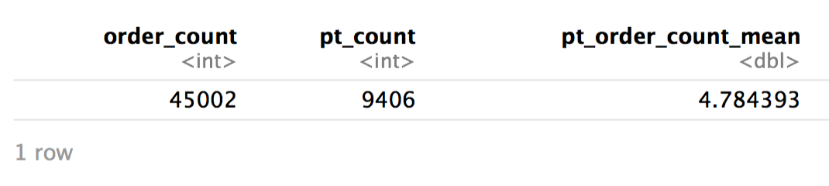
Calculate:
1) Mean count of orders per patient
orders_1 <- orders %>%
summarize(order_count = n(),
pt_count = n_distinct(patient_id)) %>%
mutate(pt_order_count_mean = order_count / pt_count)
Notes:
Since mean is the sum of observations divided by the count of the observations, we can calculate means by calculating these individual components and then dividing the sum by the count.
Note, this could also have been done in several steps, in which each step were saved to an object and then that object were passed to the next command.
Notice the variable naming convention used here. We tried to use variable names following tidyverse conventions, in which the name fully describes the variable, but is as compact as possible. These are tough! For example, order_count could be simplified to count, but then it would not be distinguishable from pt_count. We have added the summarization operation to the end of the variable name (e.g. xxxxxxxx_mean) so the source quantity comes first, but this could be reversed and placed at the front.

Slide 12
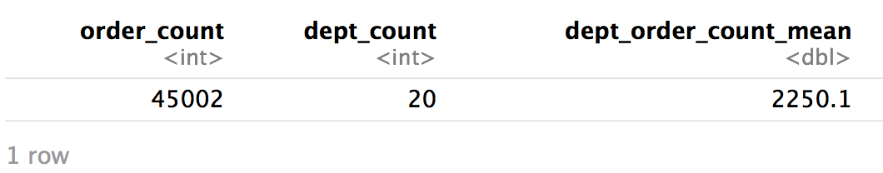
Calculate:
2) Mean count of orders per department
orders_1 <- orders %>%
summarize(order_count = n(),
dept_count = n_distinct(department)) %>%
mutate(dept_order_count_mean = order_count / dept_count)
Notes:
Since mean is the sum of observations divided by the count of the observations, we can calculate means by calculating these individual components and then dividing the sum by the count.
Note, this could also have been done in several steps, in which each step were saved to an object and then that object were passed to the next command.
Notice the variable naming convention used here. We tried to use variable names following tidyverse conventions, in which the name fully describes the variable, but is as compact as possible. These are tough! For example, order_count could be simplified to count, but then it would not be distinguishable from pt_count. We have added the summarization operation to the end of the variable name (e.g. xxxxxxxx_mean) so the source quantity comes first, but this could be reversed and placed at the front.

Slide 13
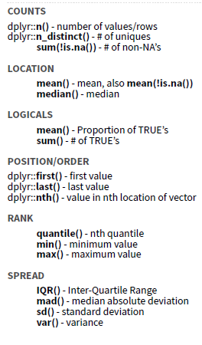
Notes:
There are many native summary functions from base R and dplyr.

Slide 14
Your Turn 2
Use summarize() to calculate:
1) The date of the first (or minimum) order
2) The median time difference between order_time and result_time
*Hint* Refer to help for NA handling
Notes:
The result_time is missing for some orders, presumably because the tests were never resulted. Missing data, indicated as NA, can be really important. Ignoring missingness can lead to incorrect interpretation due to implicit bias. Some functions will automatically throw out missing data, and just print a warning, like ggplot functions. However, others will throw and error or return NA. This can be annoying, because it creates extra work. But, it is a much safer practice, because it forces you to explicitly handle missing data.

Slide 15
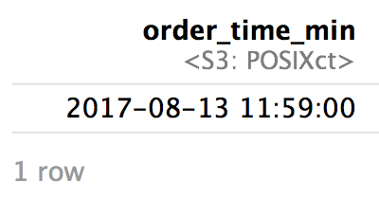
Calculate:
1) The minimum or first order date
orders %>%
summarize(order_time_min = min(order_time))
Notes:
The first() function only returns the correct result here because orders data frame is already sorted by order_time, such that the first value is also the minimum values
Subtracting result_time from order_time returns a time duration object. This object can be displayed using reasonable units automatically using the lubridate function as.duration or specifying particular units using the function difftime(time1, time2, units=“XXXXX”)
Median function returns NA if any values are missing. This can be handled upstream by filtering out missing values. Or, this can be handled within the function by using the na.rm = TRUE argument to explicitly tell the function to remove and ignore any missing values. This would also be an issue for the min function, but there is no missingness in order_time (luckily, all orders have an order time!).

Slide 16
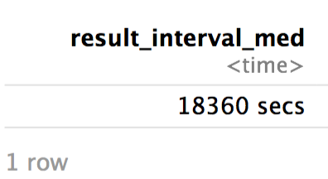
Calculate:
2) The median time difference between order_time and result_time
orders %>%
mutate(result_interval = result_time – order_time) %>%
summarize(result_interval_med = median(result_interval, na.rm = TRUE))
Notes:
Note, we could also use the first() function to return the first order_time, but only if we sort the rows based on order_time beforehand.
Subtracting result_time from order_time returns a time duration object. This object can be displayed using reasonable units automatically using the lubridate function as.duration or specifying particular units using the function difftime(time1, time2, units=“XXXXX”)
Median function returns NA if any values are missing. This can be handled upstream by filtering out missing values. Or, this can be handled within the function by using the na.rm = TRUE argument to explicitly tell the function to remove and ignore any missing values. This would also be an issue for the min function, but there is no missingness in order_time (luckily, all orders have an order time!).

Slide 17
Your Turn 3
Consider:
How would you calculate the median number of orders for each patient?
Notes:
The mean was a special case, because it can be calculated using summarize and not explicitly knowing which order is from which patient. But, to calculate the median (find the mid-point of the observations), we need to be able to assess each patient’s observations separately.

Slide 18
group_by()

Slide 19
group_by()
Notes:
Group_by is a challenging function to master, but extremely powerful. It is one of those tools that once you understand how to use, you cannot possibly go back to live without it.
The idea is simple. I have one big data frame and I want to break the observations up into several groups. Then, I’m going to “look at” those groups separately.

Slide 20
group_by()
Grouping observations based on a specific variable’s values
orders %>%
group_by(variable)
name of variable to group by

Slide 21
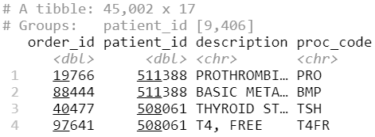
group_by()
Group observations by patient_id
orders %>%
group_by(patient_id)
Notes:
We can see that the resulting object has 45,002 rows that are broken up into 9,406 groups. Inherently, this means there are 9,406 distinct patient_id. Some of these groups will have a single observation. Many of these groups will have more than one observation.

Slide 22
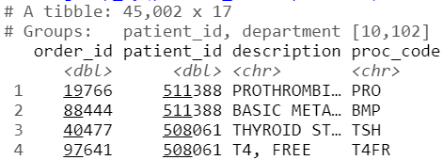
group_by()
Group observations by patient_id and department
orders %>%
group_by(patient_id, department)
Notes:
Here we are defining each group using two variables. So, each group has a unique combination of patient_id and department. This data frame has 9,406 distinct patient_id’s and 20 distinct department’s. Theoretically, we could have 9,406 * 20 = 188,120 different groups. But, there are only 10,102 groups. group_by only includes groups that are present in the data frame. It appears that in our dataset most patients are only seen in a single department, so the vast majority of theoretical patient_id-department combinations have no observations.

Slide 23
group_by() %>% summarize()

Slide 24
group_by()
%>%
summarize()
Make summaries of your data by group
Notes:
Just like we can apply summarize() to a full data frame, we can apply summarize() to each group separately.

Slide 25
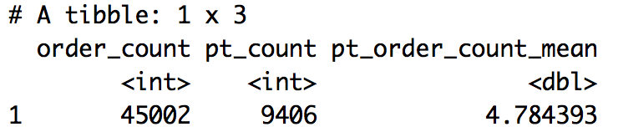
Re-calculate the mean order count per patient
Recall that we previously used summarize() and mutate() like this:
orders %>%
summarize(order_count = n(),
pt_count = n_distinct(patient_id)) %>%
mutate(pt_order_count_mean = order_count / pt_count)
Notes:
This worked for mean, because we did not need to separate out observations by patient to calculate the mean.

Slide 26
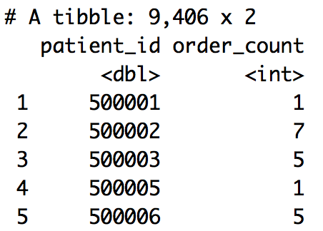
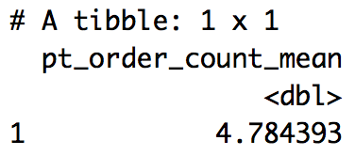
Calculate the mean order count per patient
Let’s now use group_by() and summarize()…
orders %>%
group_by(patient_id) %>%
summarize(order_count = n()) %>%
summarize(pt_order_count_mean = mean(order_count))
1
2
Notes:
Here we are nesting two levels of summarization. This can be confusing, so it is useful to walk through step-by-step. The first summarization is applied to each patient separately (groups separately). The second summarization is applied to the full data frame and summarizes the (patient) summary.

Slide 27
Your Turn 4
Calculate:
1) The median number of orders per patient
2) The maximum number of TSH orders per patient
3) (*Bonus*) The 5th and 95th percentile of the number of orders per patient (Hint: look up function `quantile()`)

Slide 28
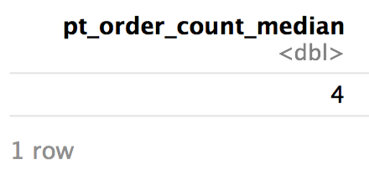
Calculate:
1) The median number of orders per patient
orders %>%
group_by(patient_id) %>%
summarize(order_count = n()) %>%
summarize(pt_order_count_median = median(order_count))
Notes:
Swap mean for median. First, calculate the number of orders per patient. Then calculate the median of those values.

Slide 29
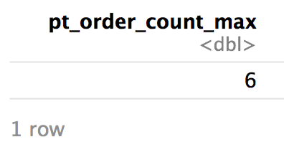
Calculate:
2) The maximum number of TSH orders per patient
orders %>%
filter(proc_code == "TSH") %>%
group_by(patient_id) %>%
summarize(order_count = n()) %>%
summarize(pt_order_count_max = max(order_count))
Notes:
To focus on `TSH` values, we need to filter the observations. The order of observations is critical here. The filter could also be applied after the group_by-summarize. But, that would be much less efficient, because it would summarize all tests and then throw out all except for TSH.

Slide 30
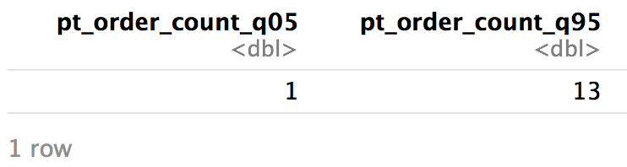
Calculate:
3) (*Bonus*) The 5th and 95th percentile of the number of orders per patient
orders %>%
group_by(patient_id) %>%
summarize(order_count = n()) %>%
summarize(pt_order_count_q05 = quantile(order_count, probs=0.05), pt_order_count_q95 = quantile(order_count, probs=0.95))
Notes:
The quantile function ranks values and identifies values at specific percentiles, such as the value such that only 5% of values are lower. This is a good way of describing a distribution, or the range of commonly observed results, especially or non-normally distributed variables.

Slide 31
Your Turn 5
Calculate the mean order count per patient for each department
Hint: summarize() rolls up a single grouping variable at a time

Slide 32
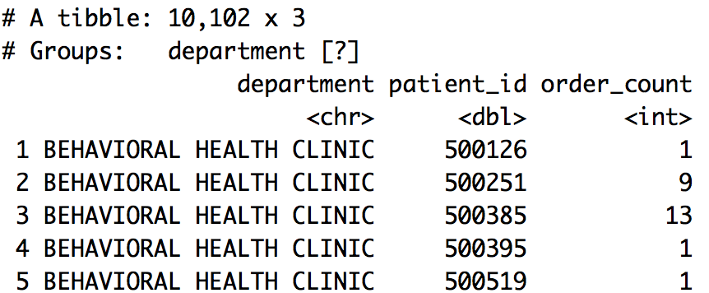
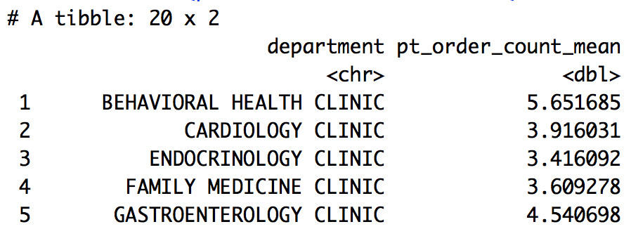
Calculate the mean order count per patient for each department
orders %>%
group_by(department, patient_id) %>%
summarize(order_count = n()) %>%
summarize(pt_order_count_mean = mean(order_count))
1
2
Notes:
Finally, the second summarize() calculates the mean order_count across patients separately within each department (group). The final result is an ungrouped data frame, because the second summarize() rolls up the department groups.

Slide 33
Compare two sets of count data

Slide 34
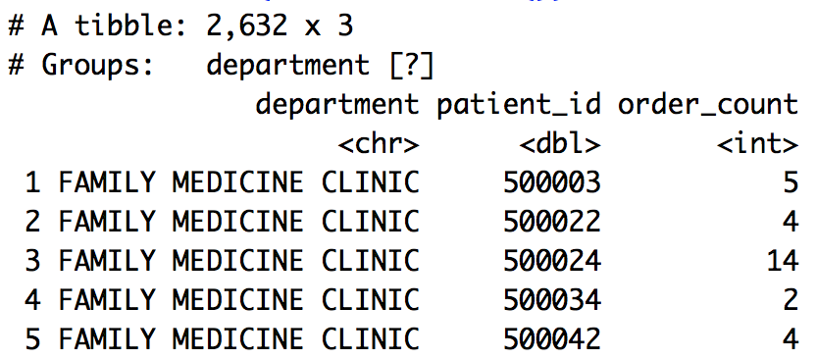
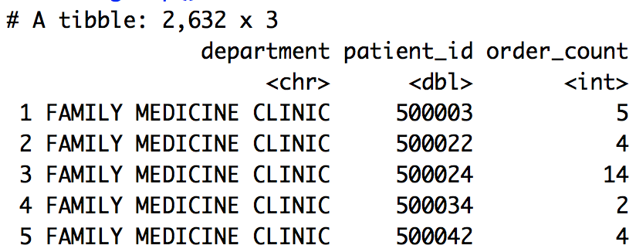
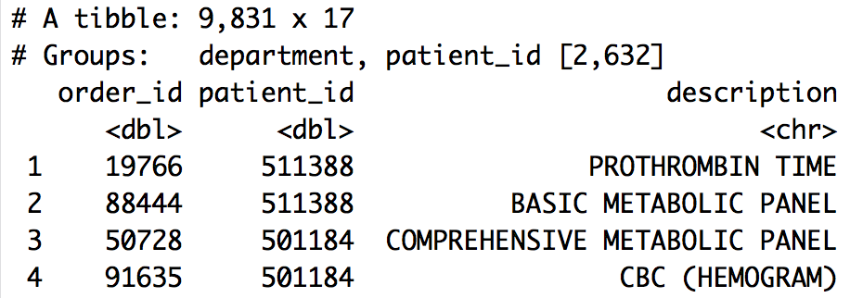
Compare sample distributions
Create the order counts per patient for 2 departments
orders %>%
filter(department %in% c("INTERNAL MEDICINE CLINIC",
"FAMILY MEDICINE CLINIC")) %>%
group_by(department, patient_id) %>%
summarize(order_count = n()) %>%
ungroup() -> orders_per_pt_dept
1
2
3
Notes:
Underlying question:
Is the distribution of the count of orders per patient different in the Internal Medicine and Family Medicine clinics?
Here we calculate order counts for all department-patient_id combinations and then only keep 2 specific departments. As we said before, this would be more efficient if the filter() were applied before the group_by()-summarize()
Also, note the use of the function ungroup(). This does what is sounds like. It undoes or rolls up all groups, returning an ungrouped data frame. This is necessary in this code chunk, because summarize() only rolls up a single group (patient_id). But, we have no need to summarize over departments, so we just ungroup().

Slide 35
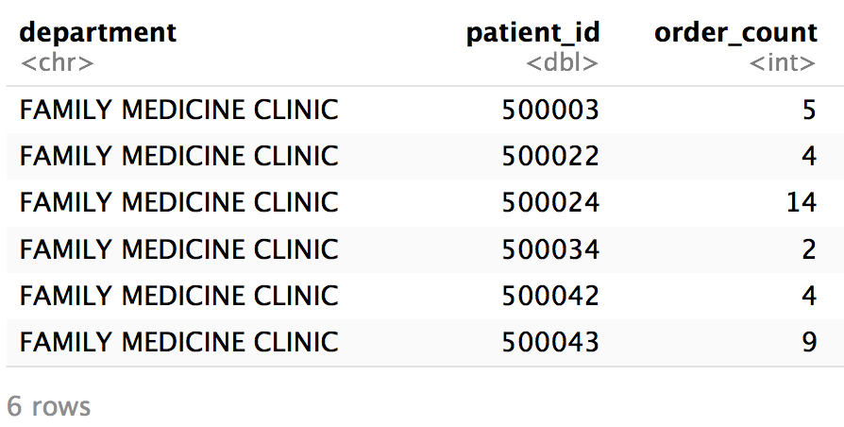
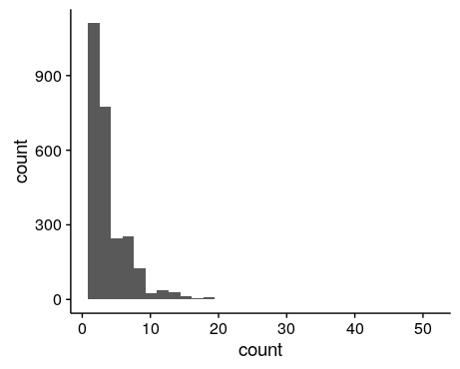
Visualize the distribution of order counts
orders_per_pt_dept
orders_per_pt_dept %>%
ggplot() +
geom_histogram(aes(x = order_count))
Notes:
We can plot a histogram using our ggplot skills. Note, here it could be informative to log-scale the axes or plot departments separately.
Order_count appears to not be normally distributed. There is a large right or positive skew. We could quantify the rightward skew in this population using the skew() function in the packages `psych` or `e1071`. A right-skewed distribution is very common for count variables, as well as many lab test results for which low values are much more common than higher values.

Slide 36
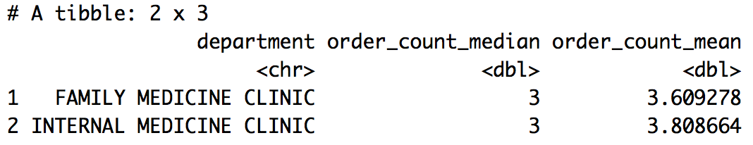
Describe the central tendency of the order count
orders_per_pt_dept
orders_per_pt_dept %>%
group_by(department) %>%
summarize(order_count_median = median(order_count),
order_count_mean = mean(order_count))
Notes:
Data appeared non-normally distributed with a rightward skew, so we see that our mean is higher than our median (as it is shifted right by rarer, high values).

Slide 37
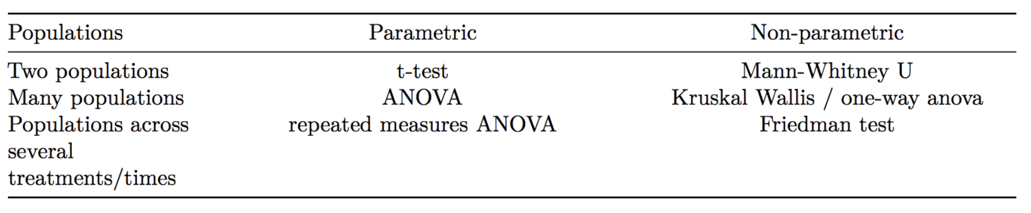
What test can compare count distributions?
Notes:
R has functions for common statistical tests

Slide 38
wilcox.test()
dependent or outcome variable
tilde operator
grouping or predictor variable
wilcox.test(measure ~ group,
data = orders, ...)
additional arguments
data frame
Compare distributions by rank order
Notes:
Mann-Whitney U-test or Wilcoxon rank-sum test evaluates the null hypothesis that a randomly sampled value from group 1 is equally likely to be greater than or less than a randomly sampled value from group 2. It tests whether the distribution of values in each group is the same

Slide 39
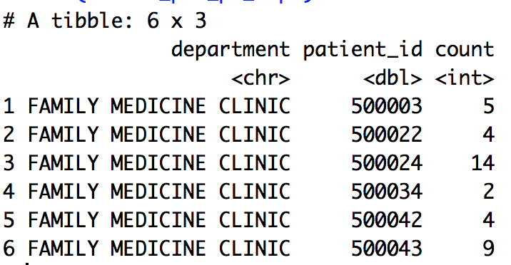
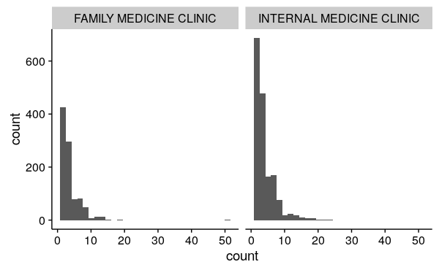
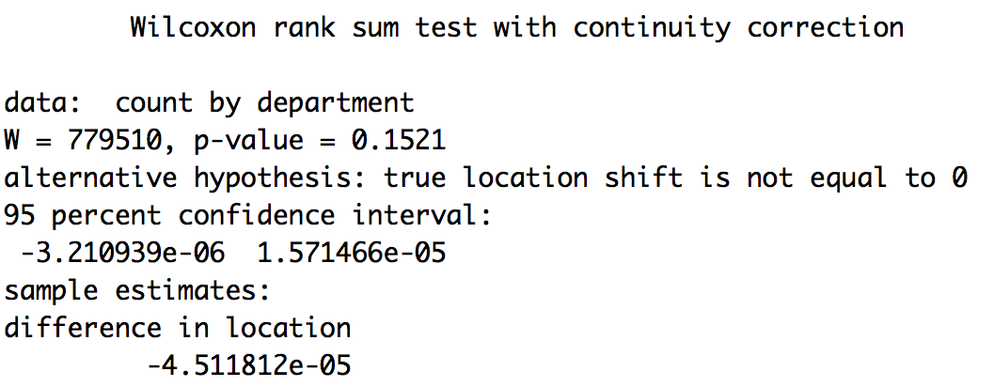
Compare order count distributions between 2 departments
orders_per_pt_dept
Wilcoxon rank-sum test
wilcox.test(order_count ~ department,
data = orders_per_pt_dept,
alternative = "two.sided",
paired = FALSE,
conf.int = TRUE)
Notes:
Interpretation: Results do not provide evidence for a difference in the number of tests ordered per patient between these two departments. P-value is not significant. Effect size estimate is very low (-4 x10^-5)

Slide 40
Your Turn 6
Compare order counts across the nephrology, cardiology, and gastroenterology departments.
*Hint: Convert department to a factor using function factor()

Slide 41
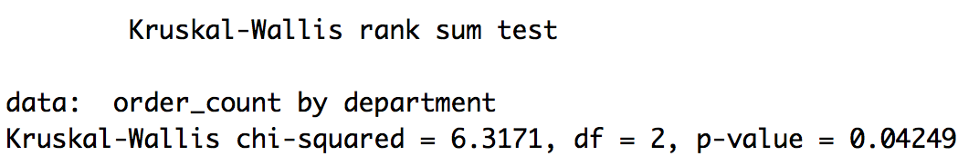
Compare order counts across the nephrology, cardiology, and gastroenterology departments
orders %>%
mutate(department = factor(department)) %>%
filter(department %in% c("NEPHROLOGY CLINIC",
"CARDIOLOGY CLINIC",
"GASTROENTEROLOGY CLINIC")) %>%
group_by(department, patient_id) %>%
summarize(order_count = n()) %>%
ungroup() %>%
kruskal.test(order_count ~ department,
data = .)
Notes:
Kruskal-Wallis test evaluates how likely it is that the distributions in the groups originate from the same distribution.
Interpretation: Results suggest the pt order counts are differently distributed in at least one of these departments
Note:
The `.` is a shortcut to refer to the data frame that is passed by the pipe operator %>%. This `.` is implied in tidyverse functions, but needs to be explicitly passed as a value for many other functions
The factor function converts the department variable from a character string to a factor. This data type is necessary for the grouping variable in the kruskal.test function
Would have been more efficient to apply the filter before the group_by-summarize

